Slide 1

Mini Project-I (K24MCA18P) Odd Semester Session 2024-25
ONLINE VOTING SYSTEM
Abhi Srivastava and 2426MCA1873
Anand Patel and 2426MCA1755
Alok Kumar and 2426MCA1291
Project Supervisor:
Supervisor Name: Divya Singhal

Slide 2
Content
Introduction (1 slide)
Literature Review (2 slides)
Objective of the Project (1 slide)
Technology
Hardware Requirements (Development Environment, Server requirement (if required), Client requirement (if required).
Software Requirements (Language and Platforms like Frameworks, VS code, Android Studio and Jupyter notebook etc. )
Modules (2-3 slides)
Workflow (1 slide)
Reports (For Example: Project : Student Monitoring System, so reports like: Student Marks, Subjects, companies visit, and student appears in placement etc.)
References (1 slide)
Notes:
Font Styles: Times New Roman + Font Size: 25

Slide 3
Introduction
Definition of Voting Systems.
An online voting system is a software platform that allows groups to securely conduct votes and elections.High quality online voting system balance ballot security,accessibility and the overall requirements of an organization’s vote events.
eoftware platform that allows groups to securely conduct votes Significance of Online Voting.
Enhances accessibility for voters, including those with disabilities and overseas citizens.
Provides greater convenience, allowing voters to participate from anywhere.
Reduces the time and resources required for tallying votes.
Notes:
Font Styles: Times New Roman + Font Size: 25

Slide 4
Literature Review
Importance of Voting Systems.
Voting systems are the backbone of democratic societies, providing citizens with a means to express their preferences and influence governance
Traditional paper-based voting, while historically significant, poses challenges such as long queues, accessibility issues, and potential for human error .
Emergence of Online Voting.
The evolution of technology has led to the development of online voting systems. Research by Thompson et al. (2021) highlights that online voting can increase voter turnout by offering convenient access to the voting process.
Notes:
Font Styles: Times New Roman + Font Size: 25

Slide 5
Literature Review (Contd.)
Security Measures: The integrity of an online voting system is contingent upon rigorous security protocols, including end-to-end encryption and secure authentication.
User Accessibility: Accessibility for all voters, including those with disabilities, is crucial for the effectiveness of an online voting system.
Public Trust: Trust in the voting process is a fundamental condition for the acceptance of online voting.
Challenges Observed in the Literature.
Cybersecurity Threats.
Digital Divide.
Notes:
Font Styles: Times New Roman + Font Size: 25

Slide 6
Objective of the Project
Enhance Accessibility.
Increase Voter Participation.
Ensure Security and Integrity.
Provide Real-time Vote Tracking.
Promote Public Awareness and Education.
Gather Feedback for Continuous Improvement.
Notes:
Font Styles: Times New Roman + Font Size: 25

Slide 7
Technology (Hardware Requirements)
Development Environment.
Processor: Dual-core CPU (Intel i3 or equivalent).
RAM: 8 GB.
Storage: 250 GB HDD (preferably SSD for faster access).
Graphics: Integrated graphics are sufficient.
Network: Stable internet connection (minimum 10 Mbps download).
Client Requirements.
Processor: Dual-core CPU
RAM: 4 GB
Storage: 16 GB available space
Operating System: Windows 10/MacOS or recent Linux distribution
Browser: Latest versions of major browsers (Chrome, Firefox, Safari, Edge)
Notes:
Font Styles: Times New Roman + Font Size: 25

Slide 8
Technology (Software Requirements)
Programming Languages
Frontend:
HTML5, CSS3, JavaScript.
Frameworks such as React.js used for a dynamic user interface.
Backend:
Framework used here is Node.js.
Database Management System (DBMS):
MongoDB
Notes:
Font Styles: Times New Roman + Font Size: 25

Slide 9
Modules
User Authentication Module - Registration , Login, Password Recovery.
Election Management Module-
Election Creation: Admins can create new elections/polls with details like the title, candidates/issues, start/end date.
Election Configuration: Set rules (e.g., eligibility criteria, voting methods).
Voting Module-
Ballot Generation: Users receive a unique ballot based on their choices.
Vote Casting: Allows users to submit their votes once they have made their selections.
Confirmation: Provides users with a confirmation message post-voting.
Results Management Module-
Result Calculation: Aggregate votes and calculate results.
Result Display: Show results in real-time or after the election, based on settings.
Notes:
Font Styles: Times New Roman + Font Size: 25

Slide 10
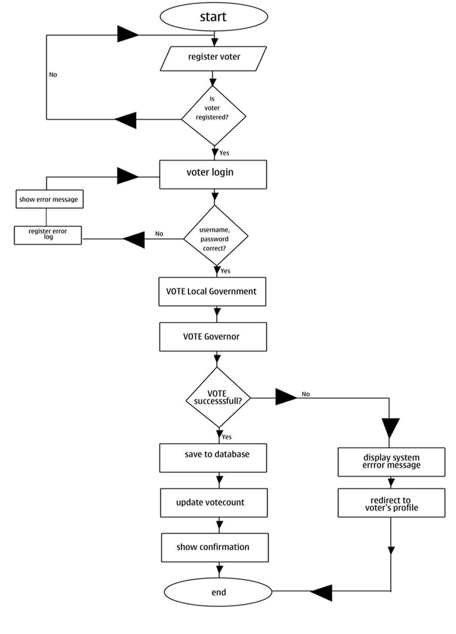
Workflow/Gantt Chart
Notes:
Font Styles: Times New Roman + Font Size: 25

Slide 11
Reports
Authentication:
Explain the authentication process (e.g., two-factor authentication, biometric verification) to ensure voter identity.
Anonymity: Describe how the system maintains voter anonymity while preserving the integrity of the votes.
Real-time Vote Counting: Discuss how votes are counted automatically, reducing human intervention.
Voter Accessibility: Highlight features designed to increase accessibility (e.g., support for visually impaired users, multi-device compatibility, and multilingual options).
Security Mechanisms
Data Encryption: Describe how data (e.g., user credentials, votes) is encrypted in transit and at rest to prevent unauthorized access.
Fraud Prevention: Explain mechanisms to prevent fraud (e.g., digital signatures, anti-tampering measures, and auditing trail.
Challenges and Risks
Security Threats: Identify potential risks (e.g., Distributed Denial of Service (DDoS) attacks, vote tampering, voter impersonation) and the countermeasures implemented.
System Scalability: Discuss challenges related to handling a large number of users concurrently during high-traffic periods like election day.
Voter Trust: Consider the challenge of convincing voters that their vote is secure and will be counted accurately.
Notes:
Font Styles: Times New Roman + Font Size: 25

Slide 12
References
Books.
A. G. A. (2015). Online Voting Systems: A Comprehensive Guide. New York: Tech Press.
H. R. (2018). Digital Democracy: How New Technologies Can Change the Way We Vote. London: Innovation Publishers.
Academic Journals.
Smith, J. D., & Wang, L. (2020). "The Effects of Online Voting on Voter Participation Rates." Journal of Elections, Public Opinion and Parties, 30(2), 234-252. https://doi.org/10.1080/17457289.2020.1731867
Thompson, A., & Patel, R. (2019). "Security Challenges in Online Voting Systems." International Journal of Information Security, 18(3), 267-280. https://doi.org/10.1007/s10207-018-0426-0
Websites.
National Association of Secretaries of State. (2023). Online Voting. Retrieved from https://www.nass.org/can-I-vote/online-voting
Election Assistance Commission. (2022). Best Practices for Online Voting. Retrieved from https://www.eac.gov/voters/best-practices-online-voting
Conference Papers.
Chen, M., & Jones, T. (2021). "Ensuring Integrity and Security in Online Voting: Challenges and Solutions." In Proceedings of the International Conference on E-Democracy (pp. 45-56). Tokyo: E-Democracy Association.
Notes:
Font Styles: Times New Roman + Font Size: 25

